Slide 1
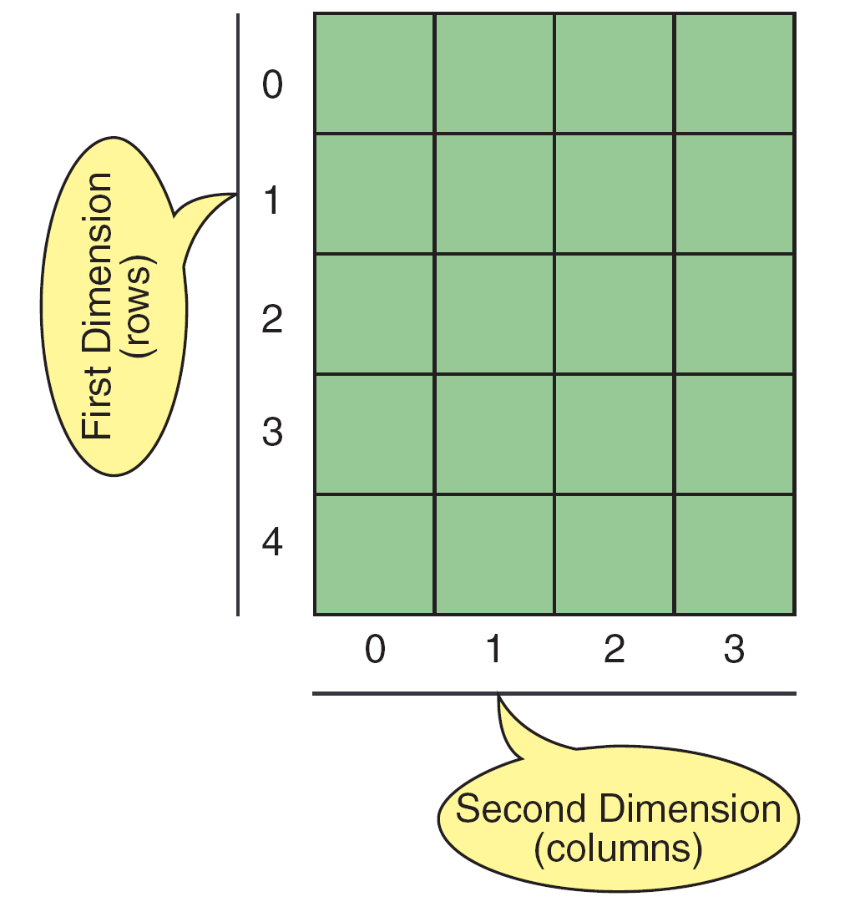
Two dimensional arrays
The 2D array is organizes the date in the form rows and columns
Ex.- store the student name, rollno, and attendance.
The data must be in rows and columns.- matrix
Declaration of two dimensional array
data type array_name[rows][columns];

Slide 2
Two dimensional arrays
2 D Array organizes the data in the form or ROWS and COLUMNS
Declaration of 2d array:
data_type array_name[rows][columns];
Ex>
int a[3][4];
int (dataType) → specifies type of element in each slot
a (array_name) →specifies name of the array
[3](rows) → specifies number of rows
[4](cols) → specifies number of columns
Initialization of two dimensional arrays
An array may be initialized at the time of declaration:
int a [3][4] = {{10,11,12,13}, {14,15,16,17}, {18,19,20,21}};
 | col0 | col1 | col2
Row0 | [0][0] | [0][1] | [0][2]
Row1 | [1][0] | [1][1] | [1][2]
Row2 | [2][0] | [2][1] | [2][2]

Slide 3
Two dimensional arrays
(i) Compile-time initialization of 2-D array:
Initialize and assign values to the arrays when we declare array variable is called compile time initialization.
int x[2][3] = {{1, 3, 0}, {4, 5, 9}};
int x[ ][3] = {{1, 3, 0}, {4, 5, 9}}; // column size is mandatory
int x[2][3] = {1, 3, 0, 4, 5, 9};
While initializing a 2-d array it is necessary to mention the column dimension. so that compiler automatically arrange the elements in rows and columns.
Row dimension is optional.

Slide 4
Accessing 2D array elements:
// Accessing 2D array elements
#include<stdio.h>
int main()
{
int arr[3][4] = { {1, 2, 3, 4}, {5, 6, 7, 8}, {9, 10, 11, 12} };
// Accessing elements using array indices
printf("arr[0][0] = %d\n", arr[0][0]);
printf("arr[0][1] = %d\n", arr[0][1]);
printf("arr[0][2] = %d\n", arr[0][2]);
printf("arr[0][3] = %d\n", arr[0][3]);
printf("arr[1][0] = %d\n", arr[1][0]);
printf("arr[1][1] = %d\n", arr[1][1]);
printf("arr[1][2] = %d\n", arr[1][2]);
printf("arr[1][3] = %d\n", arr[1][3]);
return 0;
}
To access an element of a 2D array, you need to specify both the row and the column:
nums[0][0] = 16;
printf("%d", nums[1][2]);

Slide 5
Q) write a c program to read a 2Darray and return the sum of all the elements in the 2d array.
INPUT
a[3][3] = {{1, 2, 3}, {4, 5, 6}, {7, 8, 9}}
OUTPUT:
sum= 45
LOGIC
Read the array with 3 rows and 3 cols
Read the elements
Let sum=0
loop for rows and colums
sum=sum+a[i][j];
5. Disp sum

Slide 6
Q) write a c program to return the sum of all the elements in the 2d array.
#include<stdio.h>
int main() {
int arr[3][3] = {{1, 2, 3}, {4, 5, 6}, {7, 8, 9}};
int rows = 3, cols = 3, total_sum = 0;
for (int i = 0; i < rows; i++) {
for (int j = 0; j < cols; j++) {
total_sum += arr[i][j];
}
}
printf("The sum of all the elements in the array is %d\n", total_sum);
return 0;
}

Slide 7
TWO DIMENSIONAL ARRAYS
ii) RUNTIME initialization of 2-D array:
Assigning array values during execution of the program is called runtime initialization
for(i=0; i<row_size; i++) // reads rows
{
for(j=0;j<columnsize;j++) //reads columns
{
scanf("%d", &x[i][j]);
}
}
//EX. Reading a 3 x 3 array
for(i=0; i<3; i++)
{
for(j=0;j<3;j++)
{
scanf("%d", &x[i][j]);
}
}

Slide 8
Write a program in C to read and display the elements of 2d array of 3 ROWS and 3 columns
Enter a[0][0]: 56
Enter a[0][1]: 10
Enter a[0][2]: 30
Enter a[1][0]: 34
Enter a[1][1]: 21
Enter a[1][2]: 34
Enter a[2][0]: 45
Enter a[2][1]: 56
Enter a[2][2]: 78
printing the elements ....
56 10 30
34 21 34
45 56 78
LOGIC
1. Declare a 2d array with 3 rows and 3 cols: . 2. Read the elements in corresponding row and column.
for(i=0;i<m;i++)
{
for(j=0;j<n;j++)
{
scanf("%d",&a[i][j]);
}
}
3. Print the elements of 2d array
for(j=0;i<m;i++)
{
for(j=0;j<n;j++)
{
printff("%d\t",a[i][j]);
}
}

Slide 9
//Program in C to read and display the elements of 2d array
#include <stdio.h>
int main ()
{
int a[3][3],i,j;
for (i=0;i<3;i++)
{
for (j=0;j<3;j++)
{
printf("Enter a[%d][%d]: ",i,j);
scanf("%d",&a[i][j]);
}
}
printf("\n printing the elements ....\n");
for(i=0;i<3;i++)
{
printf("\n");
for (j=0;j<3;j++)
{
printf("%d\t",a[i][j]);
}
}
return 0;
}
Enter a[0][0]:10
Enter a[0][1]:20
Enter a[0][2]:30
Enter a[1][0]:40
Enter a[1][1]:50
Enter a[1][2]:60
Enter a[2][0]:70
Enter a[2][1]:80
Enter a[2][2]:90
printing the element of a....
10 20 30
40 50 60
70 80 90

Slide 10
Q) Write a program in C to add TWO MATRICES using 2D arrays
Number of rows and columns of matrix
2 2
Enter the elements of a matrix
23 45
33 55
Enter the elements of b matrix
2 33
44 55
Sum of entered matrices:-
25 78
77 110
LOGIC
1. Declare 2 arrays a[ROWS][COLS] and b[ROWS][COLS] . 2. Read the size of matrix a and b
3. Read the elements of matrix a and b.
. for (i=0;i<m;i++)
for (j=0;j<n;j++)
scanf("%d", &a[i][j]); // similary matrix b
4.Perform addtion
for(i=0;i<m;i++)
for(j=0;j<n;j++)
c[i][j]=a[i][j]+b[i][j];
4. Print the elements c[i][j]

Slide 11
//PROGRAM TO ADD TWO MATRICES
#include <stdio.h>
int main()
{
int m,n,i,j,a[10][10],b[10][10],c[10][10];
printf("number of rows and cols\n");
scanf("%d%d",&m,&n);
printf("Enter the elements of a matrix\n");
for(i=0;i<m;i++)
for(j=0;j<n;j++)
scanf("%d",&a[i][j]);
printf("Enter the elements of b matrix\n");
for(i=0;i<m;i++)
for(j=0;j<n;j++)
scanf("%d",&b[i][j]);
printf("Sum of entered matrices:-\n");
for(i=0;i<m;i++)
{
for(j=0;j<n;j++)
{
c[i][j]=a[i][j]+b[i][j];
printf("%d\t", c[i][j]);
}
printf("\n");
}
return 0;
}

Slide 12
Q) Write a C program to multiply TWO matrices
Enter dimensions of first matrix :
2 3
Enter dimensions of second matrix
3 2
Enter first matrix (2 rows x 3 columns):
1 2 3
4 5 6
Enter second matrix (3 rows x 2 columns):
7 8
9 10
11 12
Result matrix:
58 64
139 154
LOGIC
1. Declare 2 arrays a[ROWS][COLS] and b[ROWS][COLS] . 2. Read the size of matrix a and b
3. Read the elements of matrix a and b.
. for (i=0;i<m;i++)
for (j=0;j<n;j++)
scanf("%d", &a[i][j]); // similary matrix b
4.check the cols of matrix1 with rows of matrix2
if (cols1 != rows2) {
printf("cannot multiply.\n");
5. Perform multiplication
for (int i = 0; i < rows1; i++) {
for (int j = 0; j < cols2; j++) {
int sum = 0;
for (int k = 0; k < cols1; k++) {
sum += matrix1[i][k] * matrix2[k][j];
}
result[i][j] = sum;
}
6. Print the elements c[i][j]

Slide 13
//PROGRAM TO MULTIPLY TWO MATRICES
#include <stdio.h>
int main()
{
int rows1, cols1, rows2, cols2;
printf("Enter dimensions of first matrix ");
scanf("%d %d", &rows1, &cols1);
printf("Enter dimensions of second matrix ");
scanf("%d %d", &rows2, &cols2);
if (cols1 != rows2) {
printf("cannot multiply matrices with these dimensions.\n");
return 1;
}
int matrix1[rows1][cols1]; int matrix2[rows2][cols2];
int result[rows1][cols2];
// Read first matrix
printf("Enter first matrix\N ", rows1, cols1);
for (int i = 0; i < rows1; i++)
for (int j = 0; j < cols1; j++)
scanf("%d", &matrix1[i][j]);
// Read second matrix
printf("Enter second matrix \n", rows2, cols2);
for (int i = 0; i < rows2; i++)
for (int j = 0; j < cols2; j++)
scanf("%d", &matrix2[i][j]);
// Multiply matrices
for (int i = 0; i < rows1; i++) {
for (int j = 0; j < cols2; j++) {
int sum = 0;
for (int k = 0; k < cols1; k++) {
sum += matrix1[i][k] * matrix2[k][j];
}
result[i][j] = sum;
}
}
// Print result matrix
printf("Result matrix:\n");
for (int i = 0; i < rows1; i++) {
for (int j = 0; j < cols2; j++) {
printf("%d ", result[i][j]);
}
printf("\n");
} return 0;
}

Slide 14
Q) Write a C program to find the transpose of a matrix.
The Transpose of a matrix is found by interchanging its rows into columns or columns into rows
INPUT:
{{1, 2, 3}, {4, 5, 6}, {7, 8, 9}}
OUTPUT:
Original matrix:
1 2 3
4 5 6
7 8 9
Transpose of the matrix:
1 4 7
2 5 8
3 6 9
LOGIC
Declare a 2D arrays a[ROWS][COLS] and transpose[COLS][ROWS];
Read the size of matrix a and b
3. Read the elements of original matrix
. for (i=0;i<m;i++)
for (j=0;j<n;j++)
scanf("%d", &a[i][j]);
5. Find the transpose matrix as..
for(i = 0; i < ROWS; i++)
{
for(j = 0; j < COLS; j++)
{
transpose[j][i] = arr[i][j];
};
}
6. Print the elements transpose[j][i]

Slide 15
// C PROGRAM TO FIND THE TRANSPOSE OF A MATRIX
#include <stdio.h>
#define ROWS 3
#define COLS 3
int main()
{
int arr[ROWS][COLS] = {{1, 2, 3}, {4, 5, 6}, {7, 8, 9}};
int transpose[COLS][ROWS];
int i, j;
printf("The original matrix is..");
for(i= 0;i<ROWS;i++)
{
printf("\n");
for(j = 0; j < COLS; j++)
{
printf("%d\t",arr[i][j]);
}
}
for(i = 0; i < ROWS; i++)
{
for(j = 0; j < COLS; j++)
{
transpose[j][i] = arr[i][j];
}
}
printf("\nTranspose of the matrix:\n");
for(i = 0; i < COLS; i++)
{
for(j = 0; j < ROWS; j++)
{
printf("%d\t", transpose[i][j]);
}
printf("\n");
}
return 0;
}
OUTPUT:
The original matrix is..
1 2 3
4 5 6
7 8 9
Transpose of the matrix:
1 4 7
2 5 8
3 6 9

Slide 16
Q) Write a C program to compute the sum of elements in each row of a 2D array and print the result.
Input:
{{1, 2, 3}, {4, 5, 6}, {7, 8, 9}}
Output:
6
15
24
Input:
{{2, 4}, {6, 8}}
Output:
6
14
LOGIC
Declare a 2D arrays a[ROWS][COLS]
2. Read the elements of original matrix
3 Row sum can be calculated as..
for(i = 0; i < ROWS; i++) {
row_sum = 0;
for(j = 0; j < COLS; j++) {
row_sum += arr[i][j];
}
printf("%d\n", row_sum);
}
4. Print the sum

Slide 17
//PROGRAM TO COMPUTE THE SUM OF ELEMENTS IN EACH ROW OF A 2D ARRAY
#include <stdio.h>
#define ROWS 3
#define COLS 3
int main() {
int arr[ROWS][COLS] = { {1, 2, 3}, {4, 5, 6}, {7, 8, 9} };
int i, j, row_sum;
printf("Row sums:\n");
for(i = 0; i < ROWS; i++) {
row_sum = 0;
for(j = 0; j < COLS; j++) {
row_sum += arr[i][j];
}
printf("%d\n", row_sum);
}
return 0;
}

Slide 18
Q) Write a C program to compute the sum of elements in each column of a 2D array and print the result..
Input:
{{1, 2, 3}, {4, 5, 6}, {7, 8, 9}}
Output:
12 15 18
Input:
{{2, 4}, {6, 8}}
Output:
8 12
LOGIC
Declare a 2D arrays a[ROWS][COLS]
2. Read the elements of original matrix
3 Col sum can be calculated as..
for (j = 0; j < cols; j++) {
colSum[j] = 0;
for (i = 0; i < rows; i++) {
colSum[j] += matrix[i][j];
}
}
4. Print the sum

Slide 19
// program to compute the sum of elements in each column
#include <stdio.h>
int main() {
int rows, cols, i, j;
int matrix[10][10], colSum[10];
printf("Enter the number of rows (max 10): ");
scanf("%d", &rows);
printf("Enter the number of columns (max 10): ");
scanf("%d", &cols);
printf("Enter the elements of the matrix:\n");
// Read matrix elements
for (i = 0; i < rows; i++) {
for (j = 0; j < cols; j++) {
scanf("%d", &matrix[i][j]);
}
}
// Calculate column sums
for (j = 0; j < cols; j++) {
colSum[j] = 0;
for (i = 0; i < rows; i++) {
colSum[j] += matrix[i][j];
}
}
// Print column sums
printf("Column sums:\n");
for (j = 0; j < cols; j++) {
printf("%d ", colSum[j]);
}
printf("\n");
return 0;
}

Slide 20
Q) Write a C program that takes in a 2D array of integers and returns the sum of all the elements in the array.
LOGIC
Declare a function sum_of_array
Declare a variable total_sum and initialize it to 0.
Iterate through each element of the array using nested for loops:
The outer loop iterates through each row of the array.
The inner loop iterates through each column of the current row.
At each element, add the element to total_sum.
Return total_sum.
In the main function, declare the arr 2D array
Declare variables rows and cols and set them to the appropriate values.
Call the sum_of_array function with arr, rows, and cols as parameters.
Store the returned value in a variable result.
Print out the result variable.
Input:
arr = {{1, 2, 3},
{4, 5, 6},
{7, 8, 9}}
Output:
45

Slide 21
//THE SUM OF ALL THE ELEMENTS IN THE 2D ARRAY.
#include <stdio.h>
int sum_of_array(int arr[][3], int rows, int cols)
{
int total_sum = 0;
for(int i = 0; i < rows; i++) {
for(int j = 0; j < cols; j++) {
total_sum += arr[i][j];
}
}
return total_sum;
}
int main()
{
int arr[3][3] = { {1, 2, 3}, {4, 5, 6}, {7, 8, 9} };
int rows = 3;
int cols = 3;
int result = sum_of_array(arr, rows, cols);
printf("The sum of all the elements %d\n", result);
return 0;
}

Slide 22
Q) Write a C program to compute the sum of elements above the diagonal of a square 2D array and print the result.
Input:
{{1, 2, 3}, {4, 5, 6}, {7, 8, 9}}
Output:
Sum of elements above the diagonal: 5
Input:
{{2, 4}, {6, 8}}
Output:
Sum of elements above the diagonal: 0

Slide 23
//PROGRAM TO COMPUTE THE SUM OF ELEMENTS ABOVE THE DIAGONAL OF A SQUARE 2D ARRAY
#include <stdio.h>
#define ROWS 3
#define COLS 3
int main() {
int arr[ROWS][COLS] = { {1, 2, 3}, {4, 5, 6}, {7, 8, 9} };
int i, j, sum = 0;
for(i = 0; i < ROWS; i++) {
for(j = i+1; j < COLS; j++) {
sum += arr[i][j];
}
}
printf("Sum of elements above the diagonal: %d", sum);
return 0;
}

Slide 24
Q) Write a C program to check if a given 2D array is symmetric or not.
A symmetric array is one that is equal to its transpose of a given matrix
1 2 3
2 4 5
3 5 6
its transpose:
1 2 3
2 4 5
3 5 6
Input:
{{1, 2, 3}, {2, 4, 5}, {3, 5, 6}}
Output:
The given 2D array is symmetric.
Input:
{{1, 2}, {3, 4}}
Output:
The given 2D array is not symmetric.

Slide 25
//PROGRAM TO CHECK IF A GIVEN 2D ARRAY IS SYMMETRIC OR NOT.
#include <stdio.h>
#define ROWS 3
#define COLS 3
int main() {
int arr[ROWS][COLS] = { {1, 2, 3}, {2, 4, 5}, {3, 5, 6} };
int i, j, flag = 1;
for(i = 0; i < ROWS; i++) {
for(j = 0; j < COLS; j++) {
if(arr[i][j] != arr[j][i]) {
flag = 0;
break;
}
}
if(flag == 0) {
break;
}
}
if(flag == 1) {
printf("The given 2D array is symmetric.");
} else
{
printf("The given 2D array is not symmetric.");
}
return 0;
}

Slide 26
Q) Program to sort the rows of a 2D array in ascending order:.
Input:
arr[3][3] = {{3, 2, 1}, {6, 5, 4}, {9, 8, 7}};
The sorted array is:
1 2 3
4 5 6
7 8 9

Slide 27
//Program to sort the rows of a 2D array in ascending order
#include <stdio.h>
int main()
{
int arr[3][3] = {{3, 2, 1}, {6, 5, 4}, {9, 8, 7}};
int temp;
for (int i = 0; i < 3; i++) {
for (int j = 0; j < 2; j++) {
for (int k = j + 1; k < 3; k++) {
if (arr[i][j] > arr[i][k]) {
temp = arr[i][j];
arr[i][j] = arr[i][k];
arr[i][k] = temp;
}
}
}
}
printf("The sorted array is:\n");
for (int i = 0; i < 3; i++) {
for (int j = 0; j < 3; j++) {
printf("%d ", arr[i][j]);
}
printf("\n");
}
return 0;
}

Slide 28
Q) C program to arrange row elements in ascending order
Input:
int Matrix[ROW][COL] =
{ { 3, 2, 1 },
{ 5, 4, 6 },
{ 9, 8, 7 } };
OUTPUT:
Matrix:
3 2 1
5 4 6
9 8 7
Matrix after sorting row elements:
1 2 3
4 5 6
7 8 9

Slide 29
// C PROGRAM TO ARRANGE ROW ELEMENTS IN ASCENDING ORDER
#include <stdio.h>
#define ROW 3
#define COL 3
int main()
{
int Matrix[ROW][COL] = {
{ 3, 2, 1 },
{ 5, 4, 6 },
{ 9, 8, 7 } };
int i, j, k, temp;
printf("Matrix:\n");
for (i = 0; i < ROW; ++i) {
for (j = 0; j < COL; ++j)
printf(" %d", Matrix[i][j]);
printf("\n");
}
// Arrange rows elements in ascending order
for (i = 0; i < ROW; ++i) {
for (j = 0; j < COL; ++j) {
for (k = (j + 1); k < COL; ++k) {
if (Matrix[i][j] > Matrix[i][k]) {
temp = Matrix[i][j];
Matrix[i][j] = Matrix[i][k];
Matrix[i][k] = temp;
}
}
}
}
printf("Matrix after sorting row elements:\n");
for (i = 0; i < ROW; ++i) {
for (j = 0; j < COL; ++j)
printf(" %d", Matrix[i][j]);
printf("\n");
}
return 0;
}

Slide 30
Q) Write a C program for spiral array
A spiral array is a two-dimensional array (i.e., a matrix) in which the elements are arranged in a spiral pattern.
The spiral pattern starts from the top left corner of the array and moves in a clockwise direction until all the elements in the array are filled.
1 2 3 4 5
16 17 18 19 6
15 24 25 20 7
14 23 22 21 8
13 12 11 10 9
5x5 spiral array

Slide 31
Q) Write a C program for spiral array
#include <stdio.h>
#define N 5
int main()
{
int a[N][N], i, j, k=1, c1=0, c2=N-1, r1=0, r2=N-1;
while (k <= N*N)
{
for (i=c1; i<=c2; i++)
{
a[r1][i] = k++;
}
for (i=r1+1; i<=r2; i++)
{
a[i][c2] = k++;
}
for (i=c2-1; i>=c1; i--)
{
a[r2][i] = k++;
}
for (i=r2-1; i>=r1+1; i--)
{
a[i][c1] = k++;
}
c1++;
c2--;
r1++;
r2--;
}
printf("Spiral array:\n");
for (i=0; i<N; i++)
{
for (j=0; j<N; j++)
{
printf("%d\t", a[i][j]);
}
printf("\n");
}
return 0;
}

Slide 32
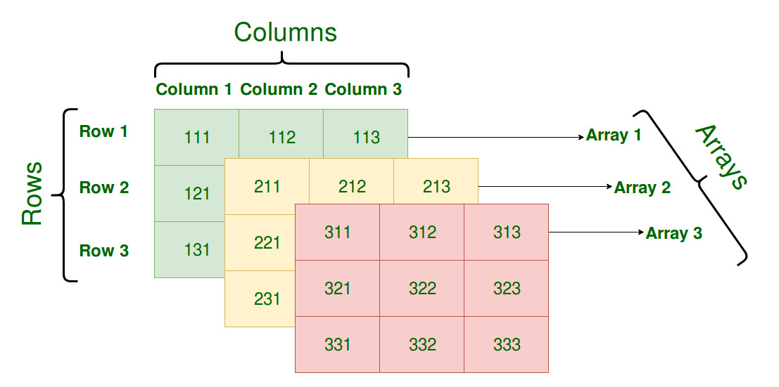
3. Multidimensional array
An array of three or more dimensions is called multidimensional array
Array declarations should understand from right-to-left
int a[10][3][2];
“an array of ten arrays of three arrays of two ints”
A Three-Dimensional Array
Syntax
data_type array_name[size1][size2]..[sizen];

Slide 33
int arr[3][3][3] ;
Declaration of Three-Dimensional Array
array of three Array of 3 rows and 3 columns arrays
Initializing Three-Dimensional Array
int x[3][3][3] = {
{{111,112,113}, {121,122,123}, {131,132,133}},
{{211,212,213}, {221,222,223}, {231,232,233}},
{{311,312,313}, {321,322,323}, {331,332,333}},
};
Initialization in a Three-Dimensional array is the same as that of Two-dimensional arrays.
The difference is as the number of dimensions increases so the number of nested braces will also increase.

Slide 34
Accessing 3D array elements:
{
{{ 1 2 3 } , { 4, 5, 6}, {7 ,8, 9}},
{{10,11,12} , {13,14,15}, {17,18,19}},
{{20,21,22} , {23,24,25},{26,27,28}},
}
a[0][0][0]=1 a[0][1][0]=4 a[0][2][0]=7
a[0][0][1]=2 a[0][1][1]=5 a[0][2][1]=8
a[0][0][2]=3 a[0][1][2]=5 a[0][2][2]=9
a[i][j][k] =➔ ith array jth row k th column
Array1 with 3 rows and 3 columns
Array2 with 3 rows and 3 columns
Array3 with 3 rows and 3 columns

Slide 35
Reading and displaying 3D Array elements
//Reading the 3D Array elements
printf("Enter the elements of 3d array");
for(i=0;i<2;i++)
for(j=0;j<3;j++)
for(k=0;k<3;k++)
scanf("%d",&a[i][j][k]);
//Displaying the 3D Array elements
printf(" the elements of 3d array");
for(i=0;i<2;i++)
{
for(j=0;j<3;j++)
{
for(k=0;k<3;k++)
{
printf("%d",a[i][j][k]);
}
printf("\n");
}
printf("\n");
}

Slide 36
Q) Write a C program to read and display the elements of 3D array
INPUT:
Enter 2 x 3 x 3 array elements:
1 2 3
4 5 6
7 8 9
10 11 12
13 14 15
16 17 18
OUTPUT:
Array elements are:
1 2 3
4 5 6
7 8 9
10 11 12
13 14 15
16 17 18

Slide 37
// program to read and display the elements of 3D array
#include <stdio.h>
#define ROWS 3
#define COLS 3
#define DEPTH 2
int main()
{
int arr[DEPTH][ROWS][COLS];
int i, j, k;
printf("Enter %d x %d x %d array elements:\n", DEPTH,ROWS,COLS);
for(i=0; i<DEPTH; i++)
{
for(j=0; j<ROWS; j++)
{
for(k=0; k<COLS; k++)
{
scanf("%d", &arr[i][j][k]);
}
}
}
printf("Array elements are:\n");
for(i=0; i<DEPTH; i++)
{
for(j=0; j<ROWS; j++)
{
for(k=0; k<COLS; k++)
{
printf("%d ", arr[i][j][k]);
}
printf("\n");
}
printf("\n");
}
return 0;
}

Slide 38
Q) Write a C program to find the sum of all the elements in a given 3D array.
Input:
{
{{1, 2, 3}, {4, 5, 6}, {7, 8, 9}},
{{10, 11, 12}, {13, 14, 15}, {16, 17, 18}},
{{19, 20, 21}, {22, 23, 24}, {25, 26, 27}}
}
Output:
The sum of all elements in the 3D array is: 378
Input:
{{{1, 2}, {3, 4}}, {{5, 6}, {7, 8}}}
Output:
The sum of all elements in the 3D array is: 36

Slide 39
// PROGRAM TO FIND THE SUM OF ALL THE ELEMENTS IN A GIVEN 3D ARRAY
#include <stdio.h>
#define ROWS 3
#define COLS 3
#define DEPTH 3
int main() {
int arr[DEPTH][COLS][ROWS] = {
{{1, 2, 3}, {4, 5, 6}, {7, 8, 9}},
{{10, 11, 12}, {13, 14, 15}, {16, 17, 18}},
{{19, 20, 21}, {22, 23, 24}, {25, 26, 27}}
};
int i, j, k, sum = 0;
for(i = 0; i < DEPTH; i++) {
for(j = 0; j < ROWS; j++) {
for(k = 0; k <COLS; k++) {
sum += arr[i][j][k];
}
}
}
printf("The sum of all elements in the 3D array is: %d", sum);
return 0;
}

